Slide 1


Software Security
SC359
Lec3 Securing architecture
By:
Dr. Hussien M. Sharaf
Email: dr.sharaf@from-masr.com

Slide 2
Course review
Poor software design and engineering are the root causes of most security vulnerabilities in deployed systems today.
This course takes a close look at software as a mechanism for an attack, a tool for protecting resources, and as a resource to be defended

Slide 3
Lecture outline
Architectural design patterns and product lines.
Design patterns.
Service-oriented architectures.
Dr. Hussien M. Sharaf
3

Slide 4
A. Architectural design patterns and product lines
Architectural patterns (also known as architectural styles) codify recurrent software architectures, by describing the key elements of the architecture and how they fit together.
Dr. Hussien M. Sharaf
4

Slide 5
Software architectures
A software architecture refers to the broad structure of a software system, it describes its major parts, and how they are put together and interact.
Dr. Hussien M. Sharaf
5

Slide 6
Software architectures
Some of the architectural views are:
1. The functional (or logical view), it describes:
the system’s main basic services/functional elements,
their responsibilities,
interfaces,
and primary interactions.
2. The process view, addresses concurrent aspects of the system at run-time, all system processes, start-up and shut-down.
3. The deployment view, maps the software elements onto the run-time, it describes the environment into which the system will be deployed, including processing nodes, network interconnections and disk storage facilities required;
Dr. Hussien M. Sharaf
6

Slide 7
Summary of Architecture & Design Pattern Types
Design Patterns | Architecture Patterns
Patterns for solving specific code scenarios | Patterns for the skeleton and abstract view of the software.
 | Layers Architecture
Observer Behavioral pattern | Model View Controller (MVC)
Singletons Creational pattern | Components Architecture
Factory Creational pattern | Service Oriented Architecture

Slide 8
Design Patterns
These design patterns divided mainly into three Groups:
Creational Patterns
Structural Patterns
Behavioral Patterns

Slide 9
The Layers pattern
N-Tier Architecture
The Layers pattern, help to structure the architecture of a system into groups of basic services/functionalities, each at a particular level of abstraction.
How it works: The system is structured into an appropriate number of layers, with each layer making use only of services provided by the layers below it.
Presentation/UI layer
Business/Logic/Domain layer
Data access layer
Dr. Hussien M. Sharaf
9

Slide 10
The Layers pattern cont.
When to use it: Applies in the development of large complex systems, which require decomposition.
Example: Networking protocols (e.g. the ISO OSI seven-layer model) that describe how computers communicate across machine boundaries and over networks. ranging from the physical layer (dealing with transferring electrical signals on a physical network) up to the application layer (dealing with transferring data between remote applications).
Dr. Hussien M. Sharaf
10

Slide 11
The Layers pattern
Advantages:
separation of concerns: each layer addresses a particular group of related services/functionalities, so that all the groups of functionalities are kept separate.
lowered coupling: the dependency between layers is kept low by following clearly stated rules, typically from high- to low-level layers;
reusability: general services (for instance access to remote devices over a network) are kept separate from speciﬁc application logic and hence are potentially reusable.
Maintainability & ﬂexibility: because of low coupling and separation of concerns, changes in elements of the system are localized and hence easier to achieve; entire layers may be replaced with alternative implementations of the same basic services.
Disadvantages :
replication: there may be a need to replicate information across layers;
performance: there may be a need to perform extra transformations at each layer.
Dr. Hussien M. Sharaf
11

Slide 12
The Layers pattern
SAQ 1
What are the main issues addressed by the Layers pattern and what are the main mechanisms used to address them?
How does the adoption of the pattern facilitate reuse and ﬂexibility?
ANSWER...............................................................................................................
The main issues addressed by the pattern are achieving low coupling between functionalities and separating concerns. This is achieved by organizing the system elements in layers/tiers/folders, each layer addressing a particular concern.
The implementation of general services can be separated from that of other parts of the system. Hence services can be potentially reused in other applications, or their implementation replaced while still providing the same basic services.
Dr. Hussien M. Sharaf
12

Slide 13
The Layers pattern
From a design viewpoint, the main difficulty in applying the Layers pattern is to decide:
how the system should be separated into layers and
how to assign responsibility to each layer.
The basic Layers pattern includes three principal layers:
The presentation layer, handles the interaction between the users and the system; it captures user events and the system’s user interface.
The domain (or business) layer, defines the work of the system; it contains domain logic and implements domain rules.
The data source layer, handles the storage of persistent data, and networking with other systems.
There are two extra mediating layers between the principal layers:
The application layer, mediates between the presentation and domain layers; it may maintain session states, or perform transformations to consolidate disparate data for presentation.
The technical services layer, mediates between the domain and data source layers. It may contain services for persistence, transactions, load balancing, or security; or interfaces to external systems.
Dr. Hussien M. Sharaf
13

Slide 14
The Layers pattern
There are two styles (flavours) of Layers pattern:
Three-layer pattern: Principle layers (1, 2, 3)
Five-layer pattern: involves layers 1-5
We can represent a layered architecture using the UML notation for a package.
A UML package is defined to represent each layer in the two flavours of Layers pattern as shown in figure 1.
Figure 2 shows a layered view of the design for the hotel system using a UML package. The HotelChainBusiness package is the domain layer of the system and contains the whole class diagram for the hotel system.
Presentation
Presentation
Application
Domain
Domain
Technical services
Data source
Data source
(a)
(b)
Figure 1 Two flavours of the Layers pattern, represented as UML packages
Dr. Hussien M. Sharaf
14

Slide 15
The Layers pattern
SAQ 2
Describe the relationship between the two styles of Layers pattern illustrated in Figure 1.
What do you think may determine the ﬂavour of the patterns that should be adopted for the architecture of a particular enterprise system?
ANSWER...............................................................................................................
The ﬁve-layered version (Figure 1(b)) introduces two mediating layers between the fundamental layers of the three-layered version (Figure 1(a)).
Complexity and ﬂexibility are determining factors. For instance, if the relationship between the presentation and domain layers is straight forward and can be easily modiﬁed and tested, then it might be more efficient to distribute the logic between these two layers rather than introducing a third one. On the other hand, in a system that allows complex interactions to occur with a large variety of users and where changes are frequent, the introduction of an application layer might allow the logic in the two other layers to be independently modiﬁed, tested and validated. A similar argument applies to the technical services layer.
Dr. Hussien M. Sharaf
15

Slide 16
The Layers pattern
Figure 2 shows a layered view of the design for the hotel system using a UML package.
The HotelChainBusiness package is the domain layer of the system and contains the whole class diagram for the hotel system.
Dr. Hussien M. Sharaf
16

Slide 17
Figure 2. Domain layer package for the hotel system in a Layers architecture
HotelChainBusiness
HotelChain
makeReservation()
cancelReservation()
checkInGuest()
checkOutGuest()
canMakeReservation()
canCancelReservation()
canCheckInGuest()
canCheckOutGuest()
ReserverPayer
id
*
1
creditCardDetails : CreditCard
id : Identity
name
1
create()
1..*
Hotel
number
name : Name
1
createReservation()
cancelReservation()
checkInGuest()
checkOutGuest()
available()
createReserverPayer()
createReservation()
Guest
name : Name
addressDetails : Address
HowMany
create()
number
number
*
occupant
name : Name
1
1
1
*
*
1..*
1..*
0..1
occupied
Reservation
RoomType
Room
reservationDate : Date
startDate : Date
endDate : Date
number : Integer
*
1
1
*
kind : RoomKind
cost : Money
number : Integer
createGuest()
*
create()
Dr. Hussien M. Sharaf
*
17

Slide 18
Rest

Slide 19
Architecture Patterns (Cont.)
3. Multi-Tier/Layer: Objects must be grouped into tiers/layers (folders), where each tier is responsible for a common functionality of the software at a very high conceptual level.
N-Tier Architecture
MVC Architecture
Presentation/UI layer
Controller
Business/Logic/Domain layer
View
Data access layer
User
Model

Slide 20
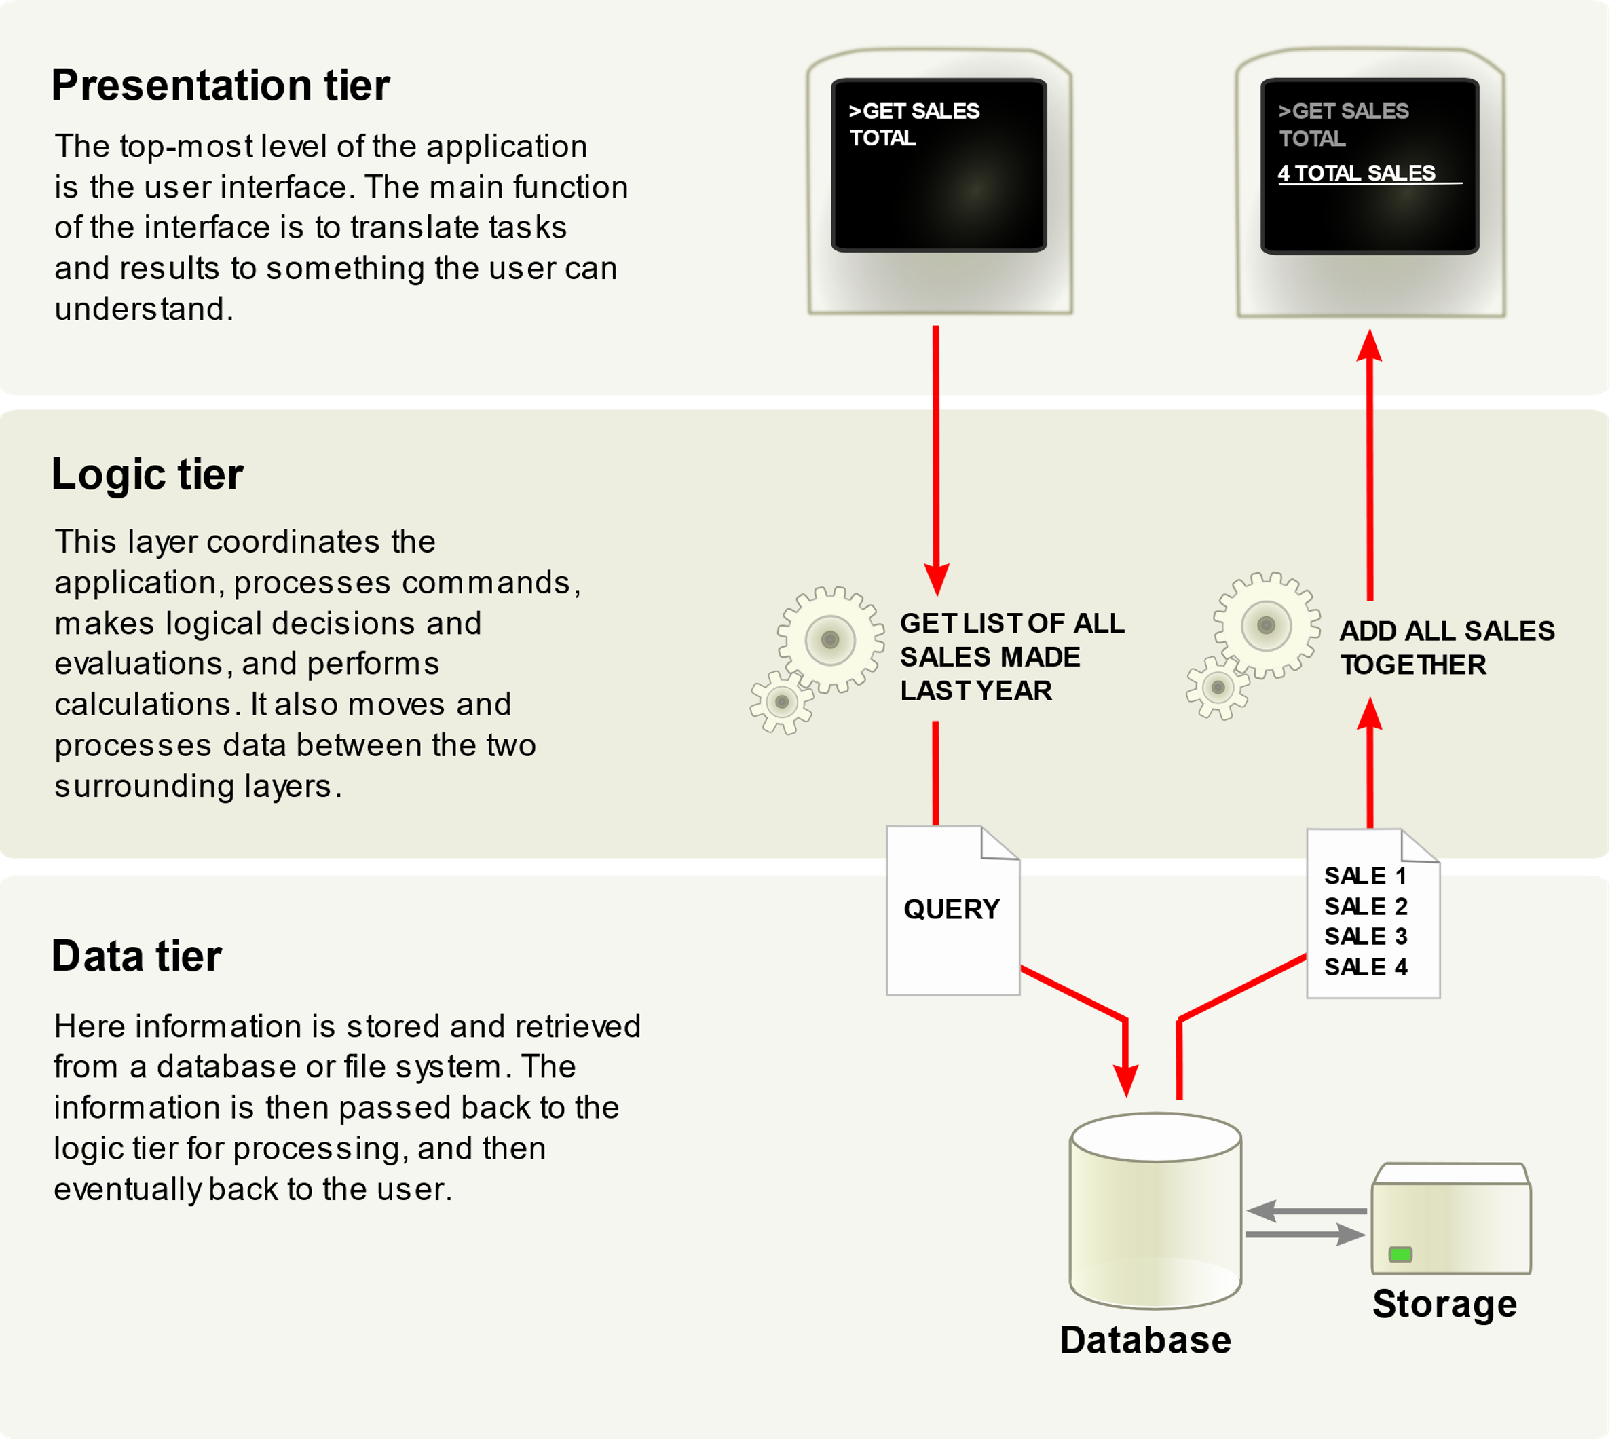
Programming Models (Cont.)
Copied from Wiki
https://en.wikipedia.org/wiki/Multitier_architecture

Slide 21
1. Model–View–Controller (MVC)
Intent To split user interface interaction into three distinct roles.
How it works It identifies three roles:
The model, corresponding to an object with some information about the domain. The model contains data and behaviour and is not a visual object. In a layered architecture, the model resides in the business layer.
The view is the graphical manifestation of the model in the user interface: it is what the user perceives of the model. Views reside in the presentation layer of a layered application.
Controllers handles all user inputs which affect the model, and are also presentation-layer objects.
Dr. Hussien M. Sharaf
21

Slide 22
1. Model–View–Controller (MVC)
The pattern works in such a way that user inputs to the controller translate into changes to the model’s state, which in turn are reflected in the view.
the view and the controller are tightly coupled to a point that they are often integrated into the same frameworks, for example, in the user interface (UI) components of Java’s Swing library. (OLD…..)
In web apps the view is the front end and usually uses Angular, VUE, or react frameworks.
Dr. Hussien M. Sharaf
22

Slide 23
1. Model–View–Controller (MVC) (Cont.)
Figure 5. Dependencies in Model-View-Controller
Figure 6. MVC structure for a clock system
Dr. Hussien M. Sharaf
23

Slide 24
1. Model–View–Controller (MVC) (Cont.)
When to use it Use this pattern to separate the presentation from the model. The advantages of this separation are many, including:
separation of concerns
ease of testing
Maintainability
The view and the controller are both dependent on the model, as shown in Figure 5.
Example Figure 6 shows an example of a Clock (the view) showing the current time of Timer (the model), with a Controller which allows the user to set the current time to an arbitrary value.
Dr. Hussien M. Sharaf
24

Slide 25
2. Customized architecture
New 8-10-2022
Logic/Domain layer: is a collection of dynamic stored procedures that can rebuild their behavior at run time based on parameters passed to them. Each business entity has one stored procedure that gathers all its operations.
N-Tier Architecture
Presentation/UI layer
Model
Domain layer
User

Slide 26
modularized architecture for Data migration
5-Nov-2022
Data Channel
Data
Source
Multi thread
API/ ODBC/ DB model
View
Controller
Driver
Exporter
Logging
Data
Destination
User

Slide 27
modularized architecture for Data migration
5-Nov-2022
Staging SQL DB
Raw
Data
Source
P1
Data Channel
P2
Raw Repo.
Unified Repo.
Export- Ready Repo.
API
Folder structure
User
P3
P4
Data Channel
Destination
P5
API
User
Folder structure
PX: is a Datachannel profile

Slide 28
3. Service-oriented architectures
Service-oriented architectures.
Service-oriented architecture (SOA) is an approach to build enterprise systems that deliver application functionality either as services to end-user applications or to build other services.
A service is an application function which is packaged as a reusable component for use in a business process.
One important characteristic of services within SOA is that they are discoverable, that is to say the consumer does not need to know about the service or where is located.
Dr. Hussien M. Sharaf
28

Slide 29
Web Service
Definition
A Web service is a software module designed to support interoperable machine-to-machine interaction over a network. It has a programming interface. Other systems interact with the Web service in a manner prescribed by its description using SOAP-messages, typically conveyed using HTTP with an XML or json serialization in conjunction with other Web-related standards [https://www.w3.org/TR/ws-gloss/]
Web API is the another form of a web application.
Web host
Where a web service is published
Requesting service
Web App
Mobile App
Desktop App

Slide 30
3. Service-oriented architectures
Service-oriented architectures.
The characteristics of a service in SOA:
A service is a self-contained and modular software entity.
It interacts with applications and other services through a loosely coupled, message-based communication model.
It supports interoperability through reliance on communication standards.
It can be found by its consumers through a registry; hence its location is transparent to them.
Dr. Hussien M. Sharaf
30

Slide 31
Enterprise components and architectures (Cont.)
Figure 12. Service collaboration in SOA: the ‘find, bind and invoke’ cycle
Dr. Hussien M. Sharaf
31

Slide 32
Thank you

